Slide 1

24CSA212 –
Full Stack Frameworks
Working with MongoDB- Installation- Basic crud operations - commands

Slide 2
MongoDB Introduction
MongoDB is a popular open-source, NoSQL database designed for high performance, scalability, and flexibility.
Unlike traditional relational databases that store data in tables, MongoDB uses a document-oriented data model, where data is stored in flexible, JSON-like documents called BSON (Binary JSON).
This allows developers to store complex data structures easily and modify schemas dynamically without affecting existing data.
Known for its ability to handle large volumes of unstructured data, MongoDB is widely used in modern web and mobile applications, especially in MEAN and MERN stack development, due to its seamless integration with JavaScript-based technologies.

Slide 3
MongoDB download
In Web browser, give mongodb download
Resources – Server – Left pane – windows – scroll down – MongoDM Community Edition -
Select accordingly
Download
Open the .exe file from downloads - install as a service – Check the installation of Compass [ Compass is a GUI version of MongoDB]
Open the Desktop icon - connect

Slide 4
Install MongoDB shell
In browser, give mongoshell download
Open .exe file – extract – open folder- bin – copy path
In cmd – environment variables – system variables – new-give name as mongosh – paste the copied path-ok-ok-ok
Open the application file of Mongoshell
Will open a cmd shell- give the command ‘mongosh’
Will see the details
cls- clear screen
exit - to exit the application

Slide 5
MongoDB shell in VS code
Open VS code – add extension – ‘Mongodb for VS code’ - Install
Click on the MongoDB icon on the left pane – connect-Right click – Launch mongodb shell
It will launch mongodb shell
Give - cd path of mongosh
.\mongosh $Env:MDB_CONNECTION_STRING;
It will prompt to test>
If its error
In VS code terminal
& ”give the path of the mongosh.exe file”
Try mongosh again

Slide 6
MongoDB shell in VS code
If its still error
&env:path [ Check whether its returning the path of mongosh]
Else
Set-Alias mongosh “path of mongosh.exe file”[ it returns the prompt if successful]
Try ‘mongosh’
Remember : its temporary. The alias now created will go away when you close VS code or terminal

Slide 7
MongoDB shell in VS code
To make it permanent, we have to add it to your powershell so that its always available
In Powershell
$PROFILE
It opens a blank notepad file
In Powershell
if (!(Test-Path -Path $PROFILE)) { New-Item -Type File -Path $PROFILE -Force }
notepad $PROFILE

Slide 8
MongoDB shell in VS code
In the new notepad file that opens, give
Set-Alias mongosh “path of mongosh.exe file”
Save the file and close notepad
Restart VS code or your powershell Terminal
After restart – open VS code – powershell – give command
‘mongosh’ - it runs
Test by giving show dbs [ will display the databases available]

Slide 9
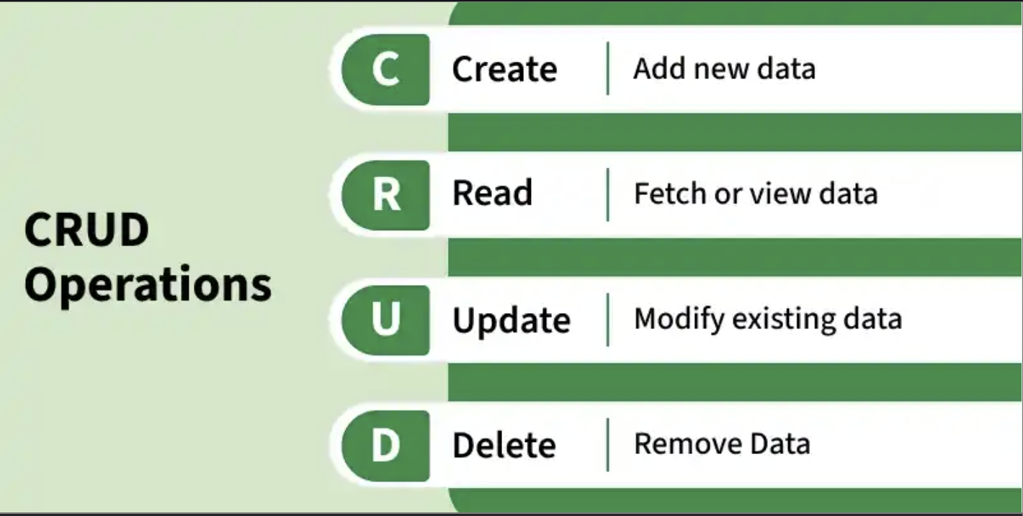
MongoDB CRUD Operations
CRUD operations are fundamental database actions in MongoDB that enable users to insert, read, update, and delete documents within collections.

Slide 10
MongoDB CRUD Operations
1. Create Operations
Create (insert) operations are used to add new documents to a collection, creating the collection automatically if it does not already exist.
Adds new documents to a collection.
Automatically creates the collection if missing.
Generates a unique _id if not provided.
Supports inserting single or multiple documents.

Slide 11
Mongosh
To use a database
use databasename [ switched to db admin]
Eg: use school
If we use ‘use’ with a non-existing db, it will create a new db
But when use ‘show’ it will not display the newly created db, because its empty.
To add a collection to the school database
db.createCollection(“student”)
Try giving ‘show dbs’ [ now it will display school also]

Slide 12
Mongosh
To drop a database
db.dropDatabase() [ will display ok:1 dropped:’school’]
To insert one document[ record] to the collection inside a db]
use school
db.student.insertOne({name:”abc”,age:30,gpa:3.2})
//field: value pair format separated by comma
To insert many document[ record] to the collection inside a db]
db.student.insertMany([
{name:”xyz”,age:32,gpa:4.0},
{name:”cde”,age:40,gpa:2.8},
{name:”mno”,age:28,gpa:2.8}
])
//field : value pair format separated by comma, as array

Slide 13

Mongosh
2. Read Operations
Read operations are used to retrieve or query documents from a MongoDB collection.
Fetch documents from a collection.
Support filtering, projection, sorting, and limiting results.
Used to read and analyze stored data.
To return all documents within a collection
db.student.find()
//an id will be automatically added to each document

Slide 14
Mongosh
We are retrieving the details of a single student from the student collection using the db.collection.findOne() method.
db.student.findOne({name:”xyz”});

Slide 15
Mongosh
3. Update Operations
Update operations are used to modify existing documents in a MongoDB collection based on specified query conditions.
Update single or multiple matching documents.
Use update operators like $set, $inc, and $unset.
Can replace entire documents if required.
We are updating the age of xyz in the student collection using db.collection.updateOne() method.
Eg.
db.student.updateOne({name:”xyz”},{$set:{age:24}})

Slide 16
Mongosh
3. Update Operations
We are updating the year of course in all the documents in the student collection using db.collection.updateMany() method.
We are replacing the complete details of a single student document in the student collection using the db.student.replaceOne() method.

Slide 17
Mongosh
4. Delete Operations
Delete operations are used to remove documents from a MongoDB collection.
Delete documents based on specific conditions.
Can remove a single document or multiple documents
Supports deleting all documents in a collection
We are deleting a document from the student collection using db.collection.deleteOne() method.
db.student.deleteOne({name:”xyz”})

Slide 18

Mongosh
4. Delete Operations
We are deleting all the documents from the student collection using db.collection.deleteMany() method.

Slide 19
Using Compass
Select db
Select the collection – ADD Data – Insert document [ a document is pre-generated for you]
{name:”uvw”,age:32,gpa,3.9}
[if there is some error, click on the format icon on the right end]
To insert many, use the format,
[name:”vvv”,age:24,gpa:3.4},
{…………………………………….},
{…………………………………….}])

Slide 20
Datatypes in MongoDB
String – a series of characters, can contain spaces or numbers
Integer – whole numbers only, not decimals
Double – decimals
Booleans – true/false
Date – created as a Date object, e.g. Date:new Date(“yyyy-mm-dd hh:mm:ss”)// new Date() will give the current date
null – store nothing
Arrays
Nested documents

Slide 21
Datatypes in MongoDB
db.student.insertOne({name:”Larry”,
age:32,
gpa:2.8,
fulltime:false,
registerDate:new Date(),
graduationDate:null,
courses:[“Biology”,”Chemistry”,”Calculus”],
address:{street:”123 xyz”,
city:”Amsterdam”,
zip:123456}
})

Slide 22
Sort and Limit documents in MongoDB
Sorting
db.student.find().sort({name:1})
//this will sort the documents in the ascending order of name
//use -1 for sorting in descending order
db.student.find().sort({gpa:-1})
// sort the documents in the descending order of gpa

Slide 23
Sort and Limit documents in MongoDB
Limit the number of documents
db.student.find().limit(1)
//will limit the number of documents to be displayed to 1
Combining sort and limit
db.student.find().sort({gpa:-1}).limit(1)

Slide 24
Using Compass for sorting and limit
Select options-
In sort option
{name:1} // -1 for descending
Enter the limit box for limiting the docs

Slide 25
Filtering
Syntax
.find({query},{projection})
Selecting a particular document
db.student.find({name:”abc”})
// will act like where class in SQL, select * from students where name=“abc”
To add or combine more filters
db.student.find({gpa:4.0,fulltime:true})

Slide 26
Filtering
Syntax
.find({query},{projection})
db.student.find({},{name:true})
//Lists all documents, but only name field
//similar to project operation in SQL
// returns id and name
//if you dont want id
db.student.find({},{_id:false,name:true})
//returns only name field with value

Slide 27
Filtering
To get name and gpa
db.student.find({},{_id:false, name:true,gpa:true})
Using Compass
Projection - In options, in projection field, {name:true} – find
Filtering – filtering field give {name:”abc”}

Slide 28
Update document in MongoDB
Syntax
db.student.updateOne({filters},{update})
Eg:
db.student.updateOne({name:”abc”},{$set:{fullTime:true})
db.student.find({name:”abc”})
//will show the updated document
db.student.updateOne({_id:……………},{$set:{fullTime:false})
//update with _id field
db.student.find({_id:………………})

Slide 29
To remove a field using Update
db.student.updateOne({_id:……………},{$unset:{fullTime:””})
//update with _id field, delete the fullTime field of the particular document
Another eg:
db.student.updateOne({name:”abc},{$unset:{fullTime:””}})
db.students.find({_id:………………})
Update Many
db.student.updateMany({},{$set:{fullTime:false}})
{} – indicates updates all documents
db.student.find()

Slide 30
Use of $exists
If we want to check whether a particular field exists within the selection criteria
db.student.updateMany({fullTime:{$exists:false}},{$set:{fullTime:true}})
// this will first check whether there is any document which doesn’t have fullTime field, if yes, it will update those documents with fullTime:true
db.student.find()

Slide 31
Update using Compass
In the main page, use the edit(pencil icon) for updating
Thrash near the field to delete a particular field
+ near the field will add new field
Can change the type also

Slide 32
Delete using MongoDB
Delete one document
db.student.deleteOne({name:”abc”})
db.student.find()
Delete Many Documents
db.student.deleteMany({fullTime:false})
db.student.find()
db.student.deleteMany({registerDate:{$exists:false}})
//deletes a document if the registerDate field doesn’t exists

Slide 33
Exporting and Importing Documents
Export
Main Page – Export – select JSON format- select file location – export-close
Import
Main Page – ADD DATA – import JSON format – select file -import

Slide 34
Comparison Operators
$ne -> not equal to
db.student.find({name:{$ne:”abc”}})
//finds every document that is not with name – abc
$lt -> less than
db.student.find({age:{$lt:20}})
$lte-> less than or equal to
db.student.find({age:{$lte:27}})

Slide 35
Comparison Operators contd…
$tg -> greater than
db.student.find({age:{$gt:20}})
$gte-> greater than or equal to
db.student.find({age:{$gte:27}})
Combining comparison operators
db.student.find({gpa:{$gte:3,$lte:4}}) gpa>=3 and gpa<=4

Slide 36
Comparison Operators contd…
IN Operator
Return all documents which have one of these matching values
db.student.find({name:{$in:[“abc”,”xyz”,”mno”]}}) // give the list as an
array
$nin -> Not IN
Does the opposite

Slide 37
Logical Operators
$and - > AND //returns true only when all the conditions are true
db.student.find({$and:[{fullTime:true},
{age:{$lte:22}}
]})
Similarly
$or ->OR //returns true when either of the condition is true
$not ->NOT //complement
db.student.find({age:{$not:{$gte:30}}}) // to get when age<30
// advantage is that it will return the document even if it is null value
$nor ->NOR // returns true when all the conditions are false

Slide 38
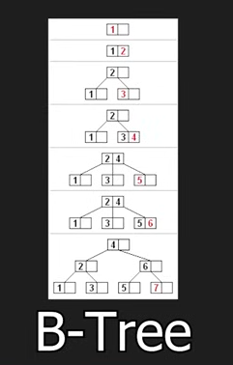
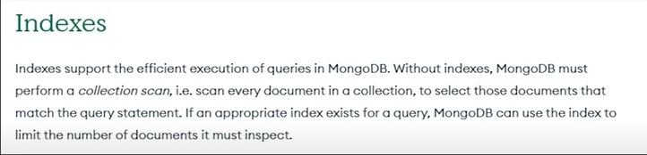
INDEXES
To get the execution status , the number of documents verified, time taken for execution etc.
db.student.find({name:”abc”}).explain(“executionStats”)
Without index, it will go through each and every document. If we have 1000 of documents, the time taken for verification will be immensely large. Hence indexes

Slide 39
INDEXES
To create indexes
db.student.createIndex({name:1} // index will be created in the ascending order of
name. -1 for descending order
On executing, it will show name_1 which is the index name
db.student.find({name:”abc”}).explain(“executionStats”)
// will show document examined – only 1, saves time
To show the indexes
db.student.getIndex()
//displays all the indexes, 1 with id(default) and another with name which we created now.

Slide 40
INDEXES
To drop an index
Syntax: db.student.dropIndex(“indexname”)
db.student.dropIndex(“name_1”)
db.student.getIndex()
In Compass
Index tab
Create Index – select field – type(ascending/descending) – create index
To Drop – click the Trash icon near the index- select the index name – drop/delete

Slide 41
COLLECTIONS
DATABASE – set of collections
show collections // will show all the collections inside a database
Create collection using parameters
db.createCollection(“teacher”,{capped:true,size:1000000,max:100},
{autoIndexID:false})
//teacher- collection name
//capped:true – set a max size limit
//if capped set to true, size should be set in Bytes,
//max:100 – sets the total document size in the collection to 100 numbers
//autoIndexId:false – prevents from creating indexes
Show collections
//lists students and teachers

Slide 42
COLLECTIONS contd…
Create another collection
db.createCollection(“courses”)
show collections //shows students, teachers, courses
To drop a collection
db.courses.drop()

